Slide 1




Future of Computing Conference
by INAM Berlin
Workshop: Computing & Sustainability
13:15 – 14:45
Carried out by:
Lukas Leitner (lakestar.com)
Gerard de Bourbon (spiritvc.com)
Sven Köppel (anabrid.com)
Lighting Talk on
Computing & Sustainability –
a scientific perspective
Dr. Sven Köppel

Slide 2

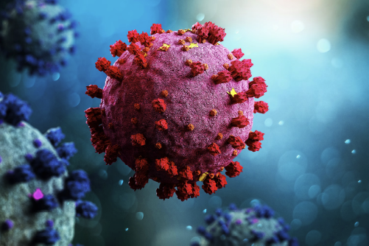
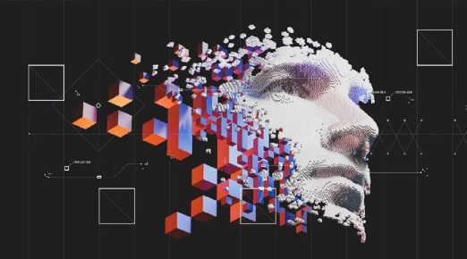
Breakthroughts thanks to Supercomputing (High Performance Computing)
Black Hole Observation 2016-19
COVID-19 antigen 2020-21
Gravitational Waveform Databases
Molecular Dynamics
Generative AI 2021-23
?
Large Language Models, Image Diffusion

Slide 3
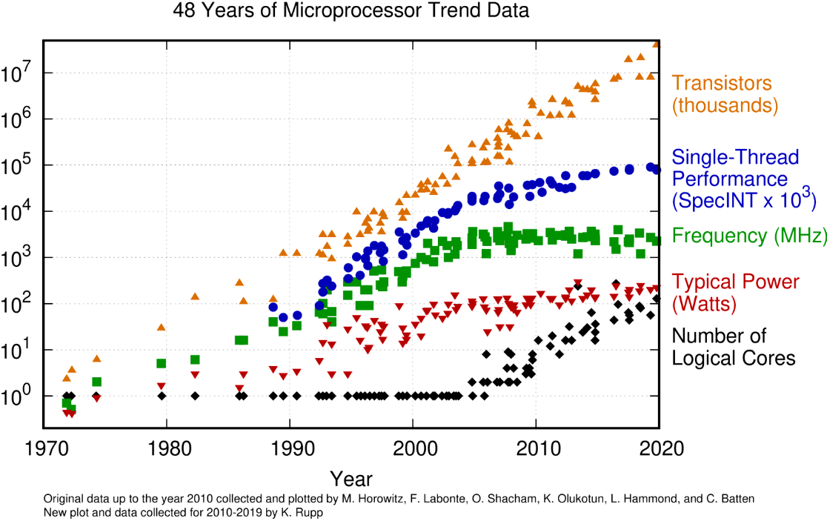
What hinders contemporary computer design to proceed?

Slide 4
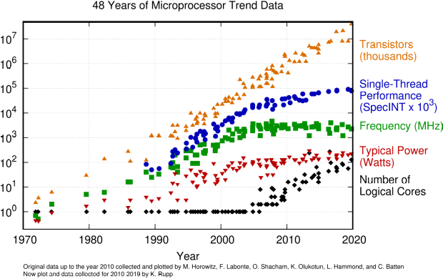
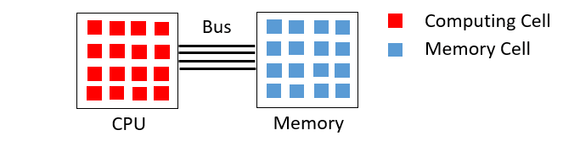
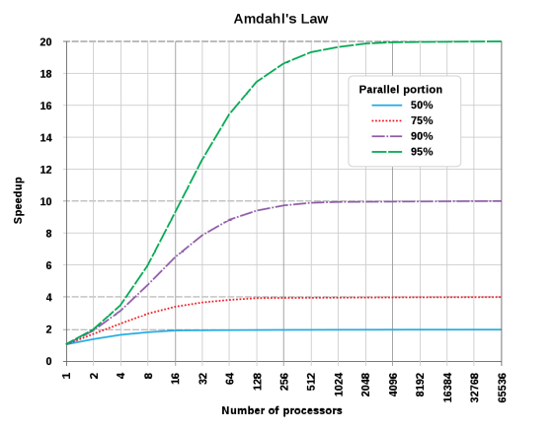
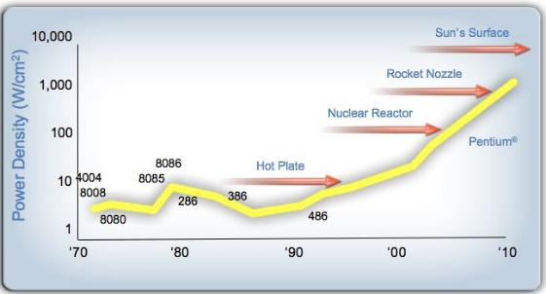
What hinders contemporary computer design to proceed?
Von-Neumann-Bottleneck
Parallelization has limits
The Energy barrier

Slide 5
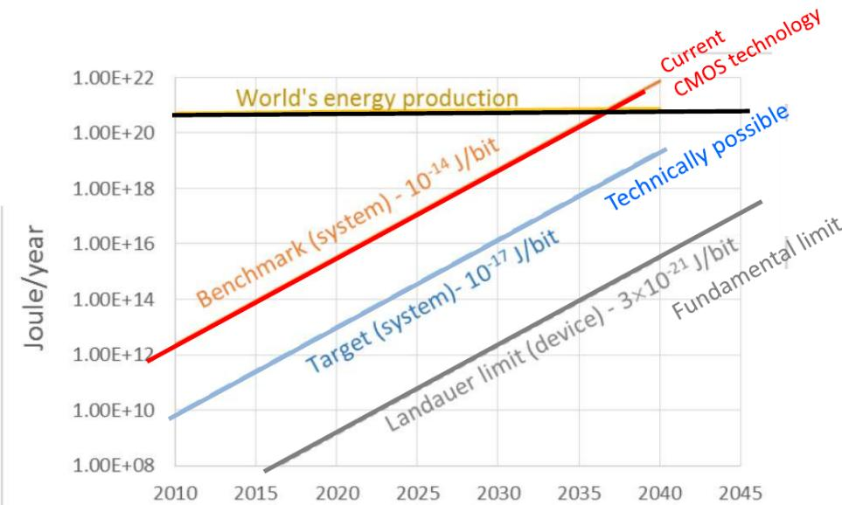
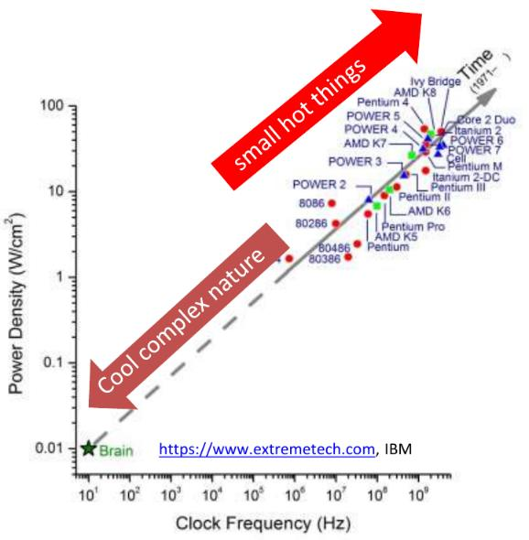
Large scale computing is all about energy
How not to do AI
Computing eats the world

Slide 6
An incomplete survey on the many dimensions of computing
Conceptual
• Communication
• Memory/Storage
• Power
? Internet
+ Green Computing
? Clouds and VMs
? IoT
+ Power prediction
+ Cooling awareness
Software
• Information
representation
• Algorithms
− Complexity
− Blockchain
+ Green Code
? Novel computing
paradigms
Hardware
• Materials
• Architecture
• Economic Scaling
? Node sizes
+ Beyond-Moore
+ In-memory comp.
+ Low power arch.
? CMOS alternatives
Society & Culture
• Geopolitics
• Ressources
• Lifetime
• Recycling
? Political
Independence
+ Open Source
+ Awareness &
Responsibility
+ Make efficiency
a value

Slide 7
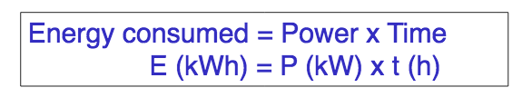
Opportunities for future computing methods
Technological promises can be:
• Less power requirements
(=less waste heat, results in less cooling)
• Faster time to solution
(=less energy even if power is the same)
• Longer lifetime (self-repairable, less wear
out, increase of compatibility, can keep up)
• Less demanding (cheaper production,
less ressources at same performance)
But also:
• Challenging for integration (ecosystem)
• „only“ postponing problems
We don’t only have a climate crisis
or an energy crisis but will have an
information crisis within decades.

Slide 8
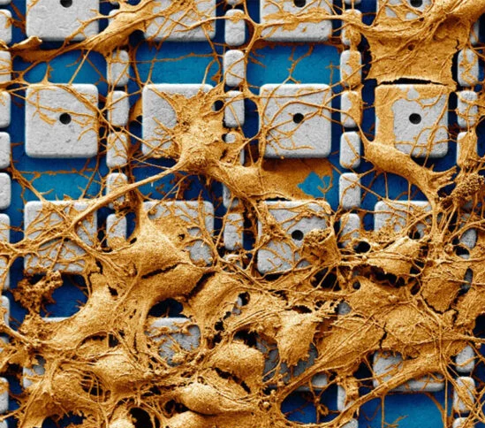
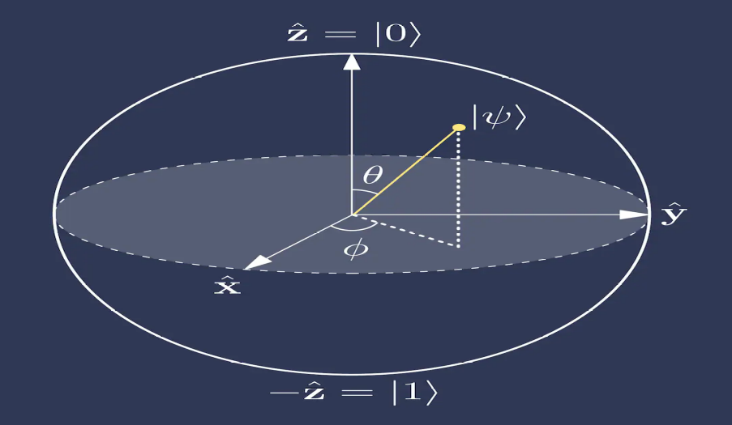
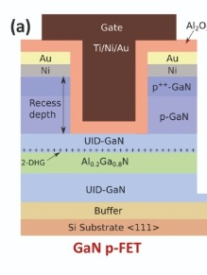
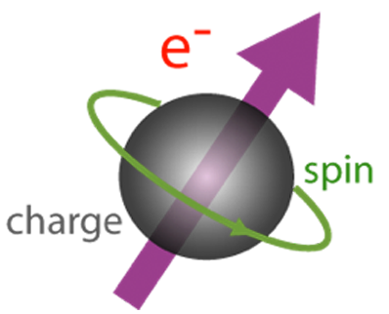
Novel Hardware: An incomplete list of unconventional computing
Advances in ICs
• GaN (only power
electronics)
• Novel Packaging
Electromagnetics
• Advances in
magnetic storage
• Memristors
• Spintronics
• Photonics/Optical
Biological Computing
• Carbon nanotubes
• Molecular electronics
• DNA storage
• Wetware
Non-Digital
• Quantum Comp.
• Analog Comp.

Slide 9
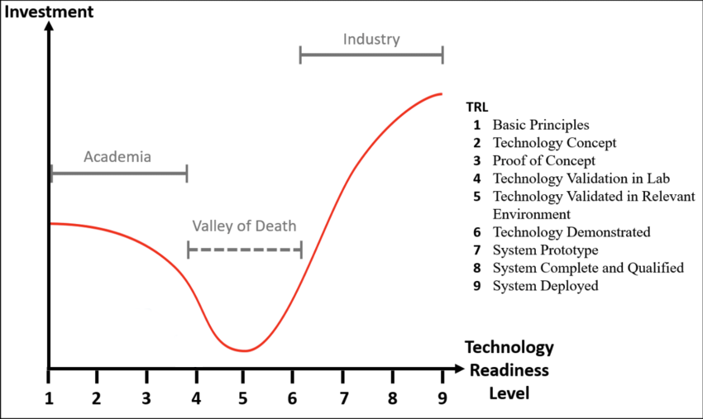
Evaluating novel Hardware: From academia to industry
• Technological Readyness Level
• Prospects of success
• Subsequent effects in Applications; Impact on Culture and Politics

Slide 10

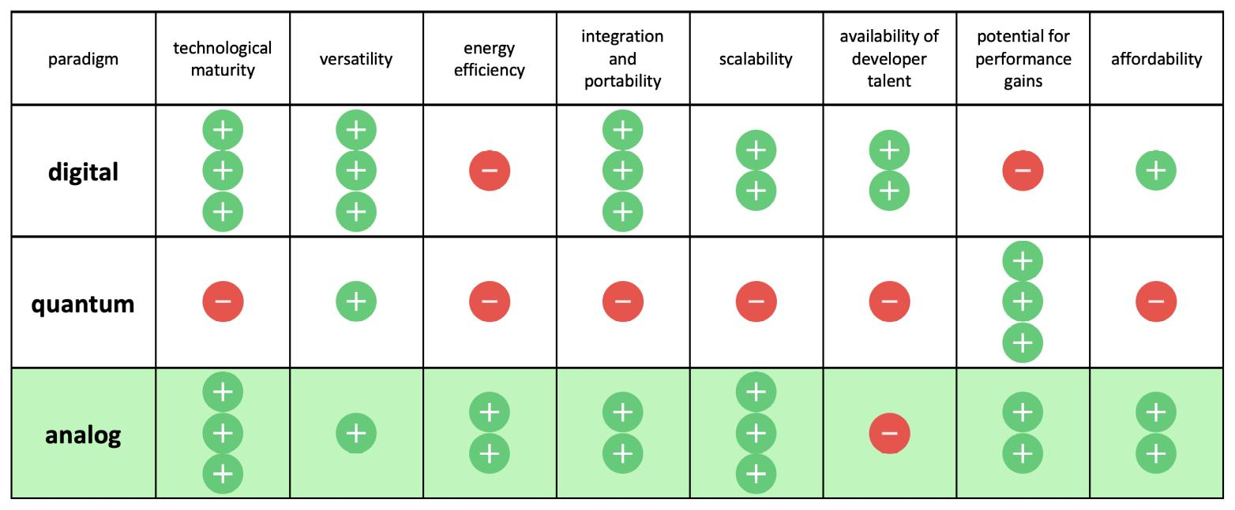
What we are actually doing
An opionionated review of popular computing paradigms

